Slide 1
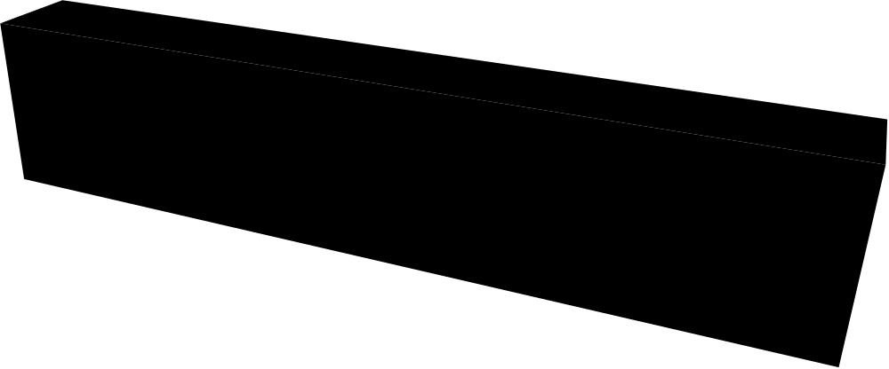
Simulation and Modeling LAB
CSE 415
Notes:
1

Slide 2
Introduction To Simulation and Modeling
Goals Of This Course
    Introduce Modeling
    Introduce Simulation
    Modeling and Simulation of a real life system
    Develop an Application for simulation
    “Learn by Doing”--Lots of Case Studies
Notes:
2

Slide 3
What Is A Model?
A Representation of an object, a system, or an idea in some form other than that of the entity itself.
(Shannon)
Notes:
3

Slide 4
Types of Models:
Physical
  Scale models
  prototype plants,…
  Real things: Blue print of a warehouse
  Mathematical
  Analytical queuing models
  Linear programs
  Chemical reaction formula
Process
  Flow Chart based Model
Notes:
4

Slide 5
What is Simulation?
Simulation
  the imitation of the operation of a real-world process or system over time
  to develop a set of assumptions of mathematical, logical, and symbolic relationship between the entities of interest, of the system.
  to estimate the measures of performance of the system with the simulation-generated data
Broadly interpreted, computer simulation refers to methods for studying a wide variety of models of systems
  Numerically evaluate on a computer
  Use software to imitate the system’s operations and characteristics, often over time
Notes:
5

Slide 6
Applications:
Designing and analyzing manufacturing systems
Evaluating H/W and S/W requirements for a computer system
Evaluating a new military weapons system or tactics
Determining ordering policies for an inventory system
Designing communications systems and message protocols for them

Slide 7
Applications: (Continued)
Designing and operating transportation facilities such as freeways, airports, subways, or ports
Evaluating designs for service organizations such as hospitals, post offices, or fast-food restaurants
Analyzing financial or economic systems

Slide 8
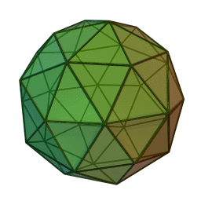

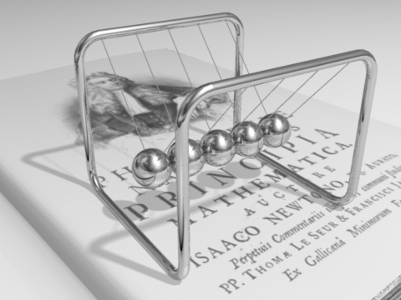
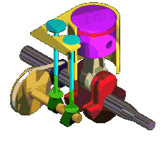

Computer Animation & Simulation
Pentakis dodecahedron (60 faces)
Notes:
8

Slide 9
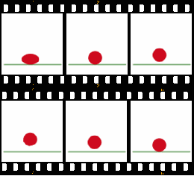

Computer Animation & Simulation
Bouncing Ball.
Simulation or Animation?
This was made in a series of still frames and when played in sequence gives the impression of movement. This is called animation and the viewer cannot interact or change the moving clip.

Slide 10
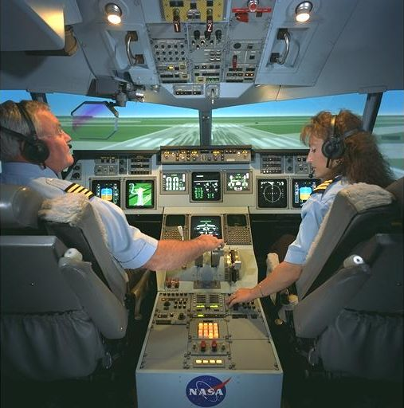
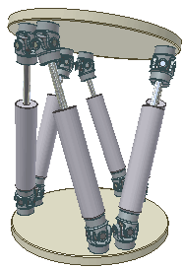
Computer Animation & Simulation
Simulators are computer models of real or proposed products which react differently depending on the input data that is entered. In this way products can be tested in a virtual environment prior to full production so design problems can be identified and modifications made.
Aircraft Flight Simulator – This type of computer model can be used for testing how the real airplane will perform prior to manufacture or for pilot training.

Slide 11
Computer Animation & Simulation
Difference Between Animation and Simulation
  Simulation is interactive – parameters can be changed and their effect analysed.
  Animation is not interactive – no changes can be made by the viewer to modify the moving image.

Slide 12
Reference Books
Text Book
  ‘Discrete-Event System Simulation’ By
  Jerry Banks, John S. Carson, Barry L. Nelson ,David M.Nicol
  ‘System Simulation’ By Geoffrey Gordon

